Slide 1
Implementing pan-European Services using national INSPIRE services: Strategic lessons learned
Mick Cory, Secretary General & Executive Director
Helsinki, 23 October 2019
Notes:
Hindsight is a wonderful thing!
EGHO / ELS inherited the achievements and the outstanding challenges of the ELF project.
Some services have been provided, participants have learned a lot – enabled many to set up and provide INSPIRE services, but building on INSPIRE services remains a challenge.
We have learned a lot about creating an operational service – realisation that we need more than a technical solution
Gaps remain to be addressed:
There is no evidence that these are solvable by EuroGeographics alone. Commercial partnership approach was tried, but has not been successful.

Slide 2
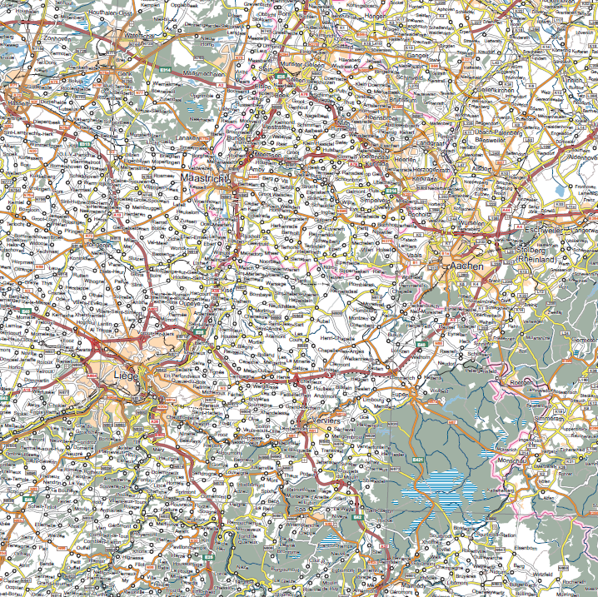
Pan-European authoritative
geospatial data and services
Policy
Different National data policy regimes
Different interpretations of privacy
Government data policy differs (eg Open Data)
Impact of Open data PSI Directive?
Policy
ISSUES to be resolved
Legal
Multiple legal jurisdictions
Centralised licensing framework vs national requirements
Multiple agreements required
Impact of Open Data Psi Directive?
Technical
Data model interpretation
Complex data schema
Client software issues
Version control
Infrastructure (Centralised vs distributed)
Data Content!
Legal
Sustainable Services
Technical
Financial
Sustainability
Financial
Notes:
Technical platform is not sustainable as currently configured
Data content - Critical gaps in data – and the data can be provided only by the Members
More countries than couple need to provide true contribution (personnel, services)
Pricing and licensing issues remain outstanding, Europe remains a complex legal and public policy environment. Proper legally binding license framework is needed. Must solve situation with countries that aren’t able to provide open data
Funding - Open data services funding needs to be discussed with EC. Finding right discussion partners in EC is critical.
Members have no means to fund setting up a pan-European operational service; in any case, Members do not want EG to be an operational service
Market – unproven commercial market; most significant user remains the EC, and related institutions. Little evidence of a desire to engage meaningfully or to invest funds to enable the services to be provided

Slide 3
Sustainability
Lessons Learned
Who pays?
Who manages / coordinates?
Organisation and leadership?
Organisation
Dataset / service user
Data suppliers
Management and coordination
Supply
Integration
Distribution
Technical Infrastructure

Slide 4
Leadership needed! A coherent approach to European geospatial policy?
In Conclusion
INSPIRE Directive is now 12 years old; concept is much older!
Things have moved on; technically and politically
New entrants, new data; AI, big data, earth observations, new technologies
UN GGIM policy framework – global sustainable development goals
Integrated geospatial implementation framework
What next for INSPIRE?
Who will take the lead in Europe?
Notes:
Compliance remains a MS responsibility – different levels of implementation – in some cases embedded in NSDI, in other cases the minimum necessary to comply
There is no requirement for the EU or its related institutions to use INSPIRE compliant services
There is no clear political or policy ‘home’ for geospatial information within Europe and the European Union. Developments at a global level, most notably within the United Nations Global Geospatial Information Management (UN-GGIM) initiative, demand a coordinated European response. The lack of an integrated geospatial policy backed up by core reference data from authoritative data providers will severely hamper the European digital economy and effective public administration. We note that elements of geospatial policy are dealt with by different parts of the European Commission, Council and Parliament, with different policy or operational priorities. As a consequence, it does not always appear ‘joined-up’ and the use of authoritative geospatial and cadastral information is inconsistent. We believe an agreed geospatial policy should be implemented horizontally across the EU Institutions, in particular the Commission, and not dealt with in silos; so that when policies are developed and proposed, they must take into account their geospatial policy and our members’ role in providing authoritative geospatial data.

